Slide 1
1953-2018

Slide 2
TSAOHN STATE CONFERENCE
NOVEMBER 02, 2017
SAN MARCOS TEXAS
WELCOME TO THE
TSAOHN 65th ANNIVERSARY

Slide 3
Texas Association of Occupational Health Nurses (TAOHN)
is dedicated to...
advancing the field of Occupational Health Care
sustaining the professional growth and development of registered nurses working in the field
providing education and certification
promoting professional recognition
collaborating with community groups and clients to facilitate the exchange of information

Slide 4
Did you know...
TSAOHN was formed in 1953 under the name the Texas Association of Industrial Nurses (TAIN) as a part of the American Association of Industrial Nurses, Inc.

Slide 5
Did you know...
TAIN was established in 1952, incorporated in 1966.
TAIN became the Texas Association of Occupational Health Nurses, Inc. in 1976.
TAOHN became the Texas State Association of Occupational Health Nurses, Inc. in 1988.

Slide 6
Did you know...
Today, six chapter associations make up TSAOHN
Austin, North Texas, Houston, San Antonio, Bay Area, Sabine, and members-at-large

Slide 7
Did you know...
The Sabine Area chapter, formed in 1942, is the oldest chapter in Texas, established in the same year as the national association.

Slide 8
OHN Job Description
1943 Civil Service
Notes:
How would you like to have that job !

Slide 9
OHN 1942 CIVIL SERVICE

Slide 10
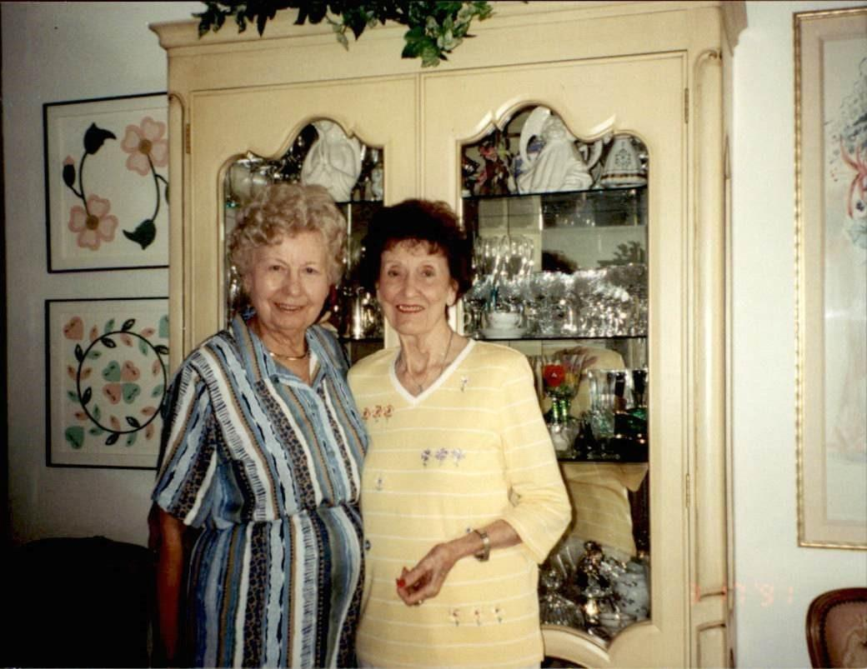
SAN ANTONIO OHN Founding Member
Notes:
It was a pleasure knowing Ruby !

Slide 11
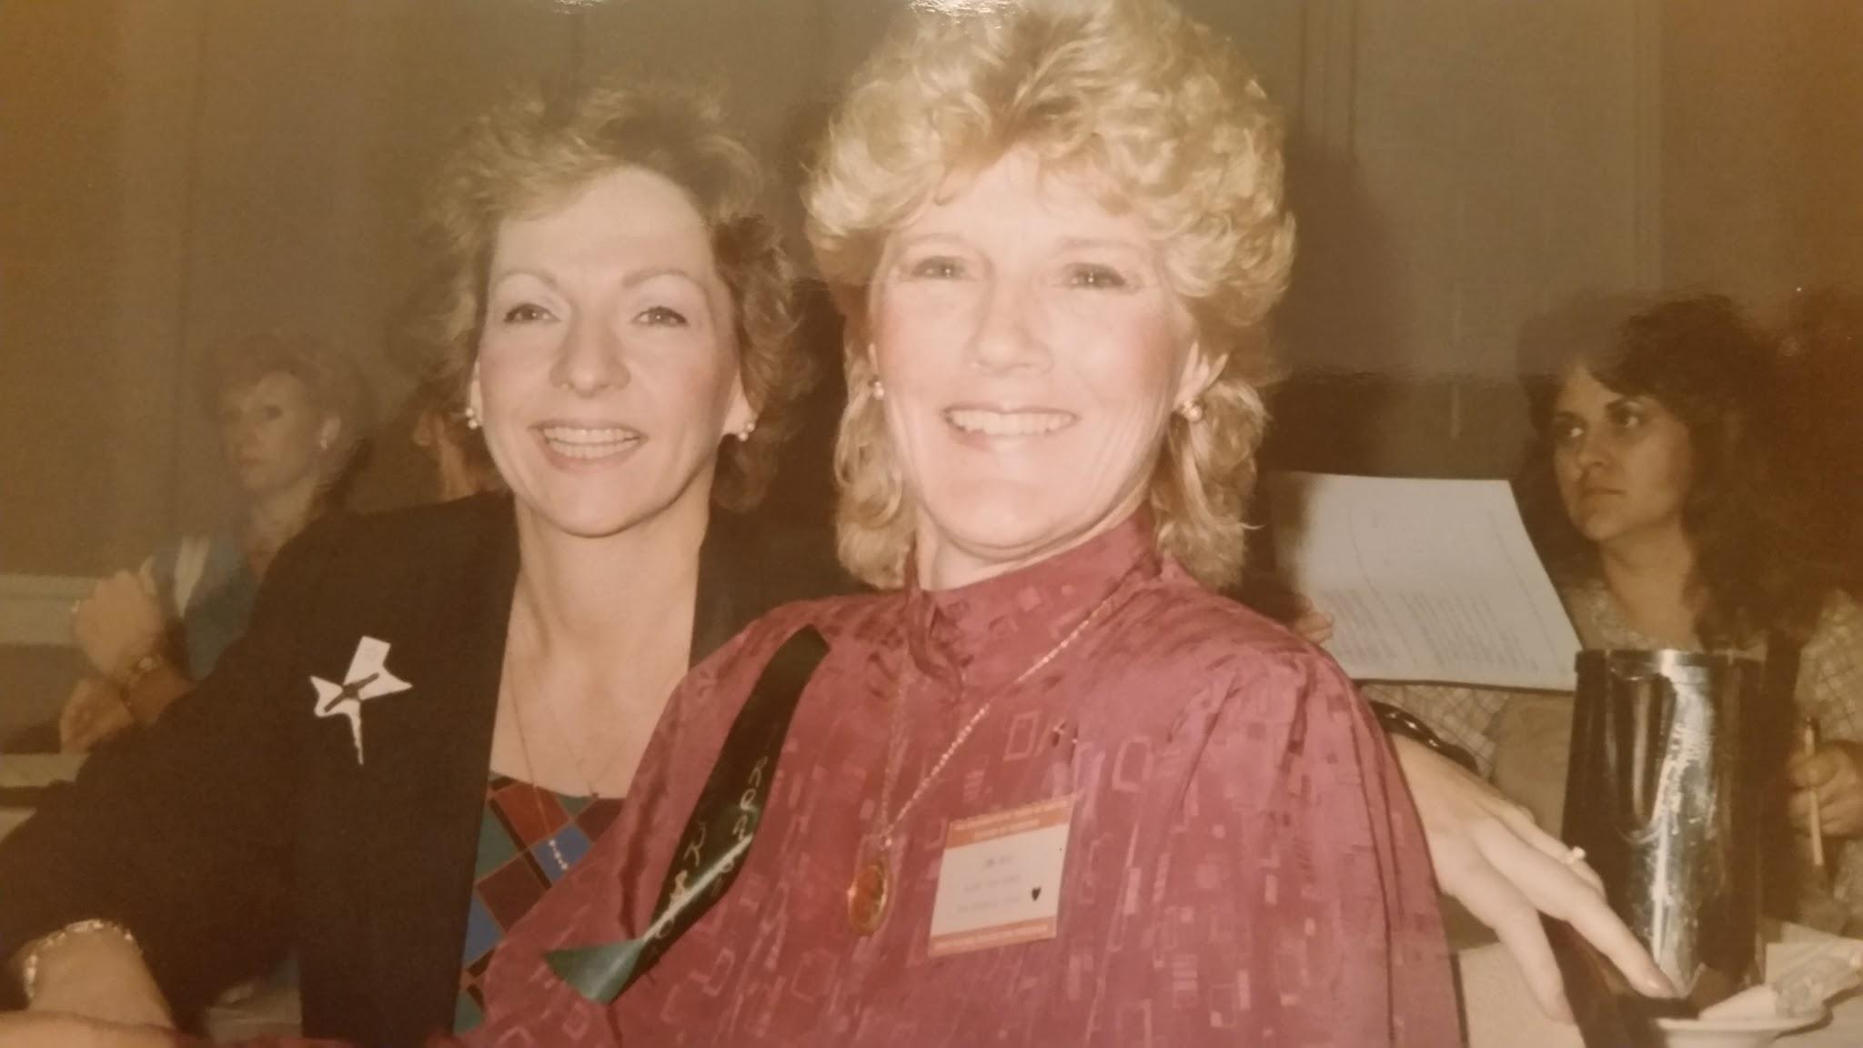
A highlight of 25 plus years of my occupational health nursing career was the very close association and participation in both local (SATAOHN) and state (TSAOHN) organization....
There were many moments of pride, but being the local coordinating committee chairman for the 1996 AAOHN national meeting held in San Antonio was my favorite.
Thanks for the friendships and the memories!
Jana Nave

Slide 12
Henry Guevara TSAOHN Past President
My greatest accomplishment as an occupational health nurse: meeting so many interesting workers and helping to provide for their respective needs. I met so many nice and wonderful people. It was a pleasure to serve them with my skills as an OHN.
As a past president of TSAOHN, my significant accomplishment dealt with using the phone conference calls for the TSAOHN board meetings. We discovered that not only were we saving the organization a great deal of money, we were also very efficient with our agenda and many times took a few hours to conduct the meeting instead of the entire day (typically, a Saturday). This was at a time when we were losing members and I felt it prudent to really keep a tab on the outgoing expenses for the organization. I hope that this made a difference!

Slide 13
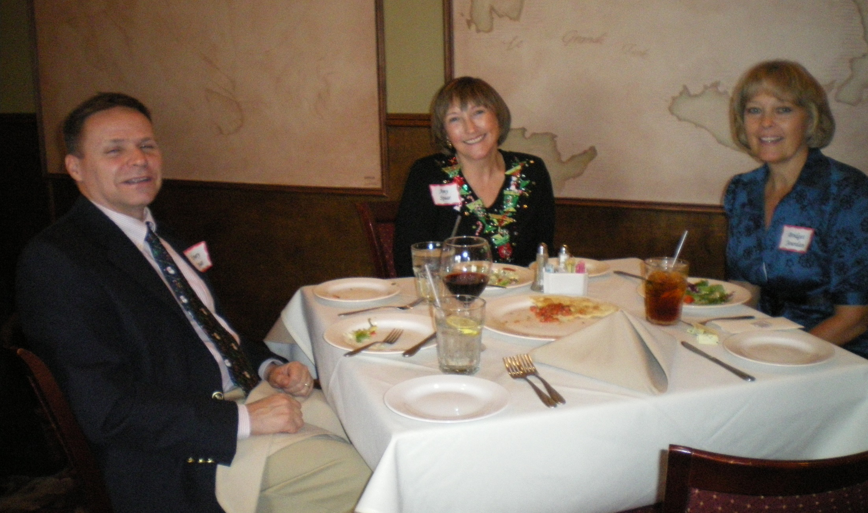
INSERT NAME

Slide 14
Linda Walker, MS, BSN, COHN-S, CCM, COHC, FAAOHNPast TSAOHN President (2011-2012):
The most important memory for me is when I first joined. I was welcomed with open arms and immediately I knew that this organization was special.
I worked with a wonderful group of nurses and they were great mentors. As my journey continued, I was elected to positions on the national level and got to see firsthand the challenges that the organization was facing. I saw the lean times and how we worked together to bring the organization back. I saw how the state and local chapters joined together to make this happen and I knew that I had made the right decision when I ventured into occupational health.
The most humbling recognition was being elected President of the State organization. I had a wonderful board to work with and their vision was to continue to make the organization better even though we were facing some very trying times. We continued what the prior boards had begun even though our membership was declining. Policies and procedures were one of our key initiatives. When hard decisions had to be made, we made them with consensus.
I see the organization as a family. I will forever be grateful for those who mentored and encouraged me. You will never know how much I appreciated all your help and leadership. You will forever hold a special place in my heart. It is my prayer that the organization will remain solid and thrive.
Notes:
Say Hi Linda when you see her here !

Slide 15
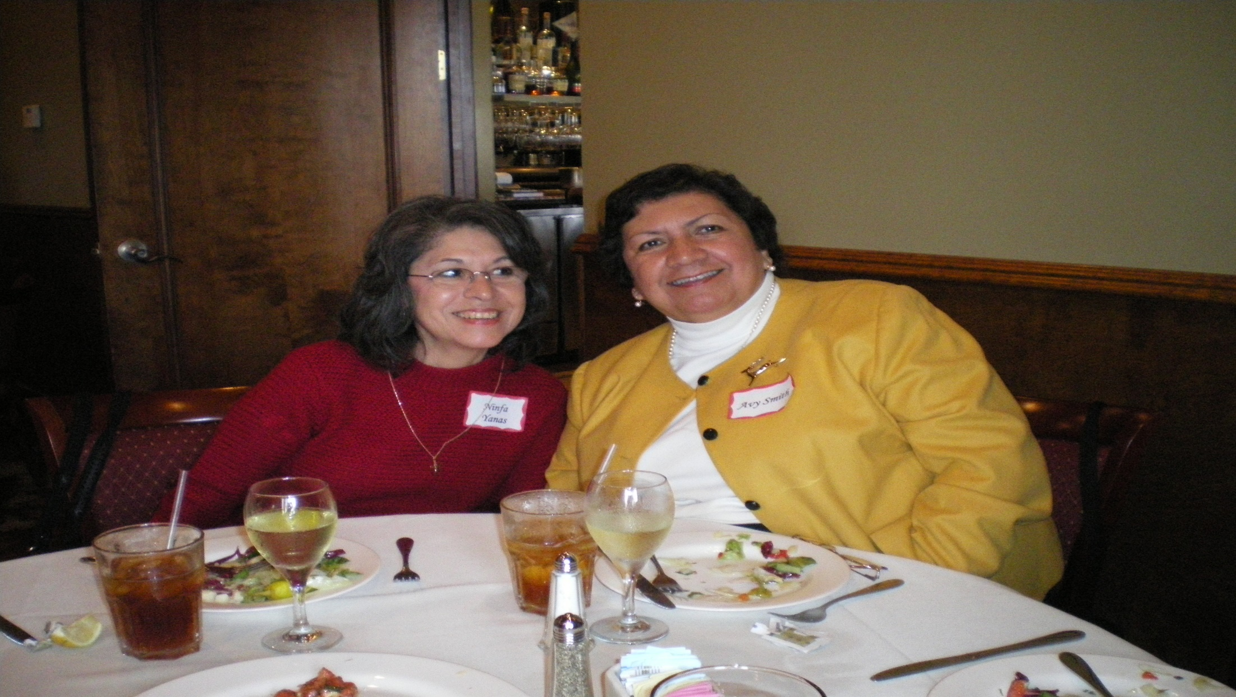
Ninfa Yanas One of our 40 year members!

Slide 16
Katherine J Moore: TSAOHN President1994-1998;
TSAOHN Vice President 1991- 1994
,
The TSAOHN web site was spearheaded by then Board Member Joanne Zimmerle. The Board provided support for her and her committee to bring this idea to fruition. Joanne Zimmerle later was TSAOHN President.
We developed and implemented 4 hour Board Orientation Program for newly elected Board members. Over time, this program was expanded to a full day and is still offered on a regular basis. We also develop the first TSAOHN Business Plan and a one day introductory course for OHNs, and the TSAOHN Certification Review Course.
Due my involvement in AAOHN, at the local, state, and national level, I had opportunities to impact OHN practice by appointments to AAOHN Committees, various nursing related committees, advisory boards and academic institutions, and to serve as Faculty for annual AAOHN Conferences for several years.
Notes:
True Texas

Slide 17
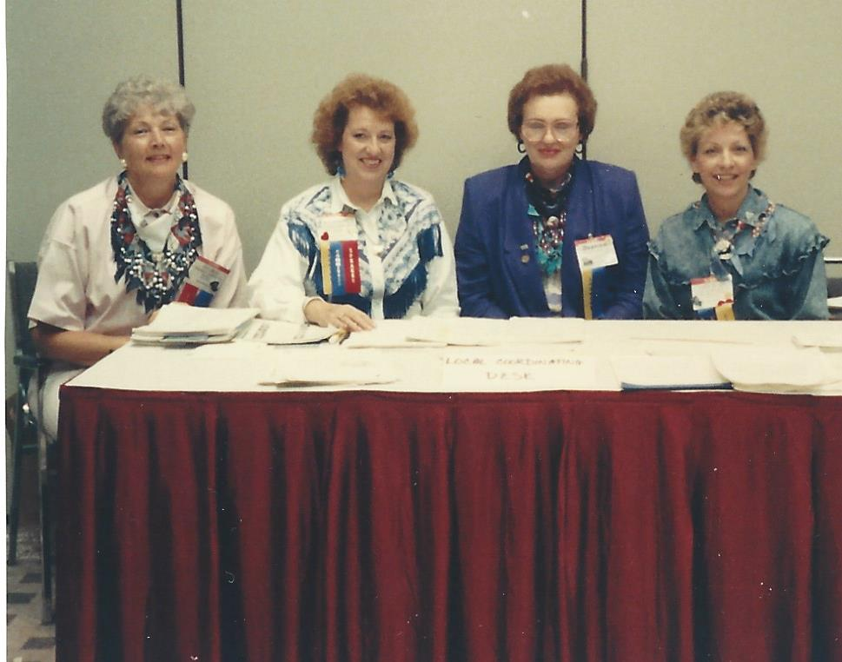
AOHC 1990

Slide 18
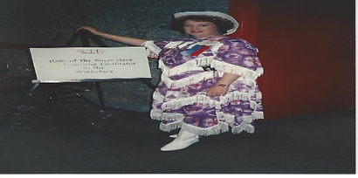
Katherine Moore
Throughout my career I received several awards, but the ones that were most meaningful to me, were receiving the TSAOHN Medique Leadership Award and later the AAOHN Medique Leadership Award. I treasure these. Nothing is more valuable to your career development as the professional and personal friendships we have received recognition from my colleagues, but also recognition for my colleagues who enabled my professional growth and development.
Every significant career opportunity I’ve enjoyed came through contacts made possible by my OHN friends, professional relationships, and networking opportunities.

Slide 19
Lady Ellen Cone-Clark: SAAOHN Treasurer 1982 – 1984; President 1984 – 1986; TSAOHN President 1986 – 1988; 1988 – 1990; TSAOHN Treasurer 1990 – 1994
Receiving any of the awards were very special to me. Most important aspect was that I was nominated by peers in the Occupational Health Nursing profession and they recognized me as being worthy of being nominated for the award. Receiving the award brought further recognition of my expertise in the field of occupational health nursing by the companies I worked for then and also in the future.
I have been awarded the Honorary Membership by both the TSAOHN State and the San Antonio Texas Association of Occupational Health Nurses. I feel thankful and blessed to have this privilege. It helps financially when I renew my AAOHN national dues and no longer need to pay for State and Local dues.
The organization has been great in professionalism, leadership development, strategic planning and in networking with other occupational health professionals. I cannot imagine not being a part of this organization. The organization has provided me with resources I needed in business and the community to help foster my career in occupational health nursing and it also allowed me the opportunity to mentor many other nurses.

Slide 20
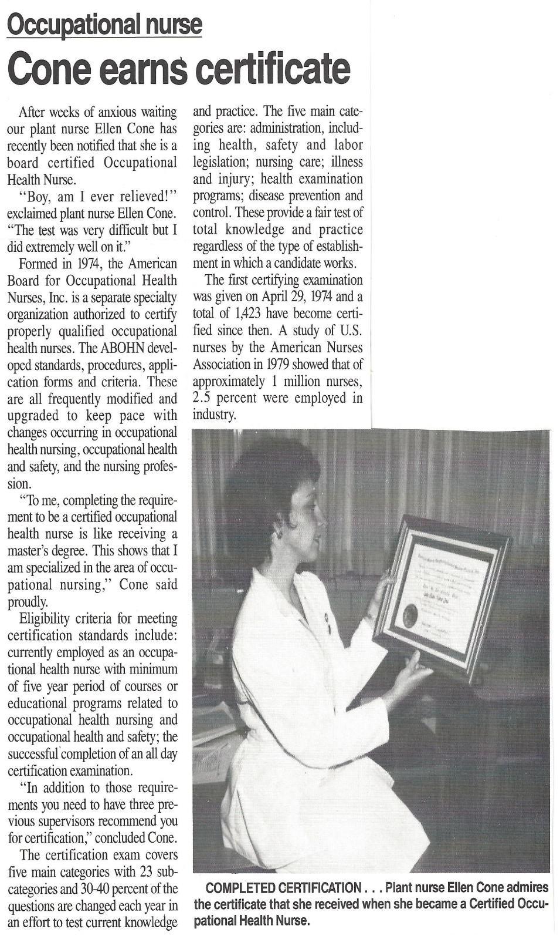
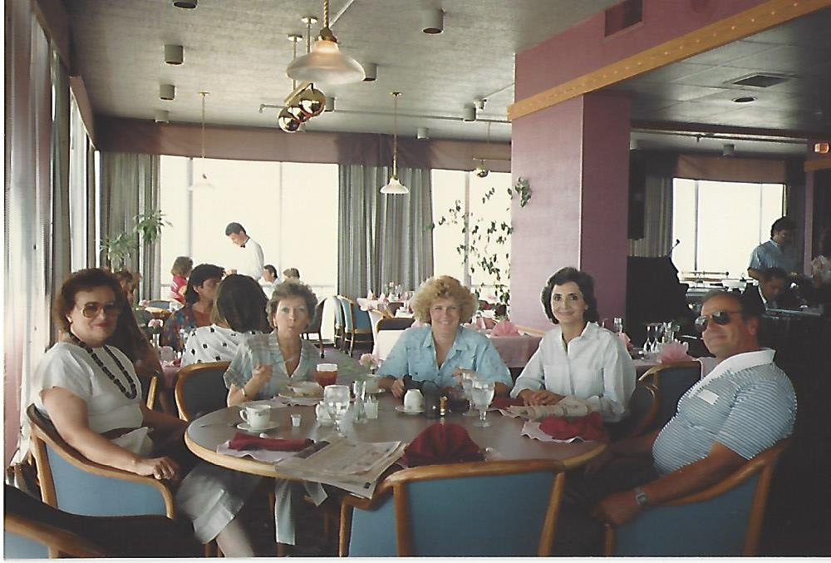
Lady Ellen Cone-Clark

Slide 21
Mark Sebastian, RN, MPH, COHN-S, FAAOHN
Most of my career I had to balance education, experience, family, civilian and military obligations. Just prior to starting the MPH I must admit I fortunately had come to a proverbial intersection, not of collision, but where everything seemed to just come together. My schedule, by boss' support including covering for me to leave early one day prior to starting the MPH. I just had to bite the bullet and keep putting one foot in front of the other.
My accomplishments came in the area of education and successfully passed another specialty board-certification previously giving some insight to requirements, but in the scheme of things I was now at opposite poles of having "the least experience" yet having to compile "the greatest aggregate of occupational health knowledge. " After all, what were they going to ask?
Passing my board-certification or my MPH at different times provided the same results: I went through a lot of discomfort but successfully passing further increased my confidence and credibility substantially. I also realized I was again in a certain accomplished minority of those that added growth and credibility to a profession that has struggled with itself over the decades far too much. Furthermore, they both opened more doors of opportunity of leadership and career fulfillment including helping the ABOHN team with a two-year Director tour.
Mark Sebastian, RN, MPH, COHN-S, FAAOHN
Captain, NC, USN(ret)Occupational & Environmental Health Branch Clinic
NAS JRB Ft. Worth, TX 76127

Slide 22
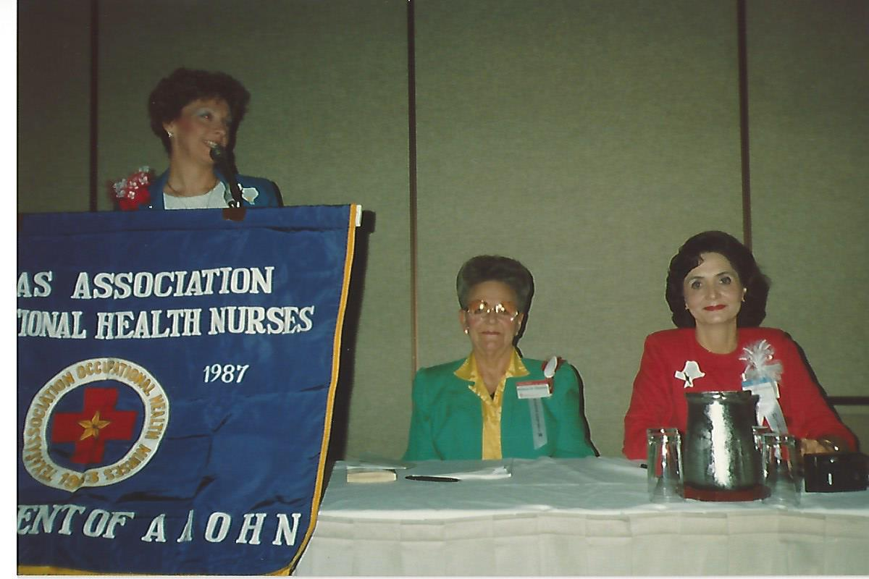
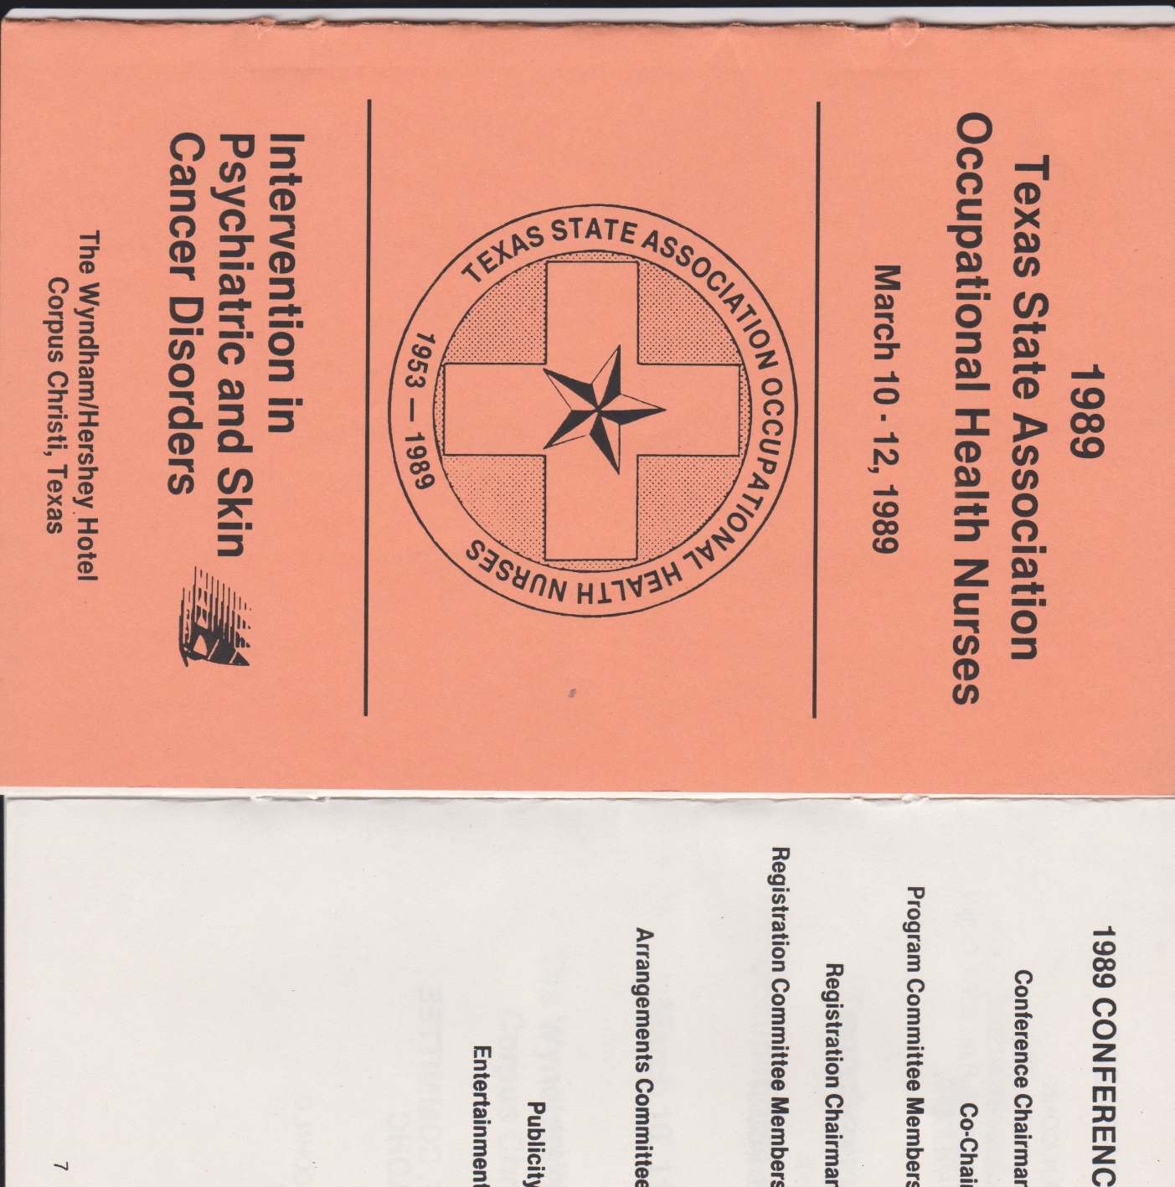
TSAOHN 1989 Conference

Slide 23
Jeanette “Jan” Schrimsher Schade, RN BSN COHN-S/CM CEASII AOEAS
People call me ‘Nurse Jan’. I am 63.5 years old and have been a nurse since 1976.
I became the first student nurse at UT to have an internship in occupational health nursing in 1980 at Motorola. After working a year post-CCU as an RN following graduation, I was hired by Motorola and worked there nine years. We rotated being on call for emergencies during the weekends carrying these large battery powered walky-talkies (no cell phones yet!). I learned so much at this job, the basics of occupational health nursing. Hearing conservation programs, respiratory protection programs, reproductive health issues, heavy metals screenings with 24 hour urine collections.
I felt like I was in the trenches, on the first line treating hundreds of employee’s issues over the years. Psych., labor and delivery, cardiac, physical abuse, men passing kidney stones, seizure disorders, deaf employees, substance abuse in the workplace, transgender staff bathroom issues (this was in the 1980s). Treating chemical burns was very common, eye rinses, hydrofluoric acid. The most memorable event was when I was on duty alone one evening about 1984 and there was a chemical leak that sent 47 people to the ER.
I am thankful that I have had the opportunities to work in occupational health and hope that I have helped hundreds if not thousands of workers solve some of their problems and make their working life better.

Slide 24
Karen Barrett, BS, RN, COHN-S, CHSP, CEAS II, FAAOHNTSAOHN and NTAOHN member
I have been very fortunate to be able to serve TSAOHN in several roles. I started out as Membership Chair for the then, Fort Worth Texas Association of Occupational Health Nurses (FWTAOHN). Lisa Kirby, who was president of FWTAOHN, ran for president of TSAOHN. As she was doing that, she told me that I should run as treasurer along with her. Her encouraging and positivity talked me into it! If you know Lisa, you understand how it all happened!! Little did I know that they had no one to run as treasurer, so I was unopposed. At election time again, no one would run as president. I stepped in and ran. That was for the 2006-2007 term. Lisa had done such a good job with me that I “pulled” a friend into running as treasurer. That was Karen Bell, who has served faithfully since then.
Our organization has been blessed to have smart women working together to keep OHNs moving forward in their professional and personal lives. It has meant the world to me to be part of such a dynamic and caring organization. The highlight of my time was when we had a conference in Austin and walked to the capitol building. We were entertained by the staff of the capitol and toured the building. At the end, I was presented with the Texas flag that had flown over the capitol and was commemorated to Texas Occupational Health Nurses!Thanks to all of you who have been part of my life in TSAOHN. You are my heart!

Slide 25
Maria G. “Lupe” Dominguez R.N.COHNS/CM
Current TSAOHN President
My first OH meeting was at Alamo Iron works with Jana Nave and Asta Vazquez in San Antonio Texas. There was something in the air that just told me that I needed to belong! It must have been all that OSHA stuff! You think it was above the limits?? Somehow very soon after that I was inducted into SATAOHN. And the rest is history. I joined the ranks of COHNS in the 1990s. Achievement award in 2007 and AAOHN Alcoa Scholarship Award.
I have been very lucky to be surrounded by great professional nurses that have also been great teachers - Mary Alice Walden, Jana, Lady Ellen, Mary Helen Ball, Lisa Kirby and the list goes on. Being on the TSAOHN board with nurses and professional like Ms. Kirby that always kept TSAOHN and the OHN as her primary concern of her business as the same level as the worker is what made her so successful. She knew that both were equally important. I have never forgotten that. Being part of SATAOHN that never gives up! We get close to closing shop but we just keep integrating all the other chapters and keep moving forward. That’s what’s it’s all about. “Improving the Health and Safety of the Texas Workforce”
Now I invite every new, young OHN to take a little piece of this history and use it to make their future bright and successful.

Slide 26
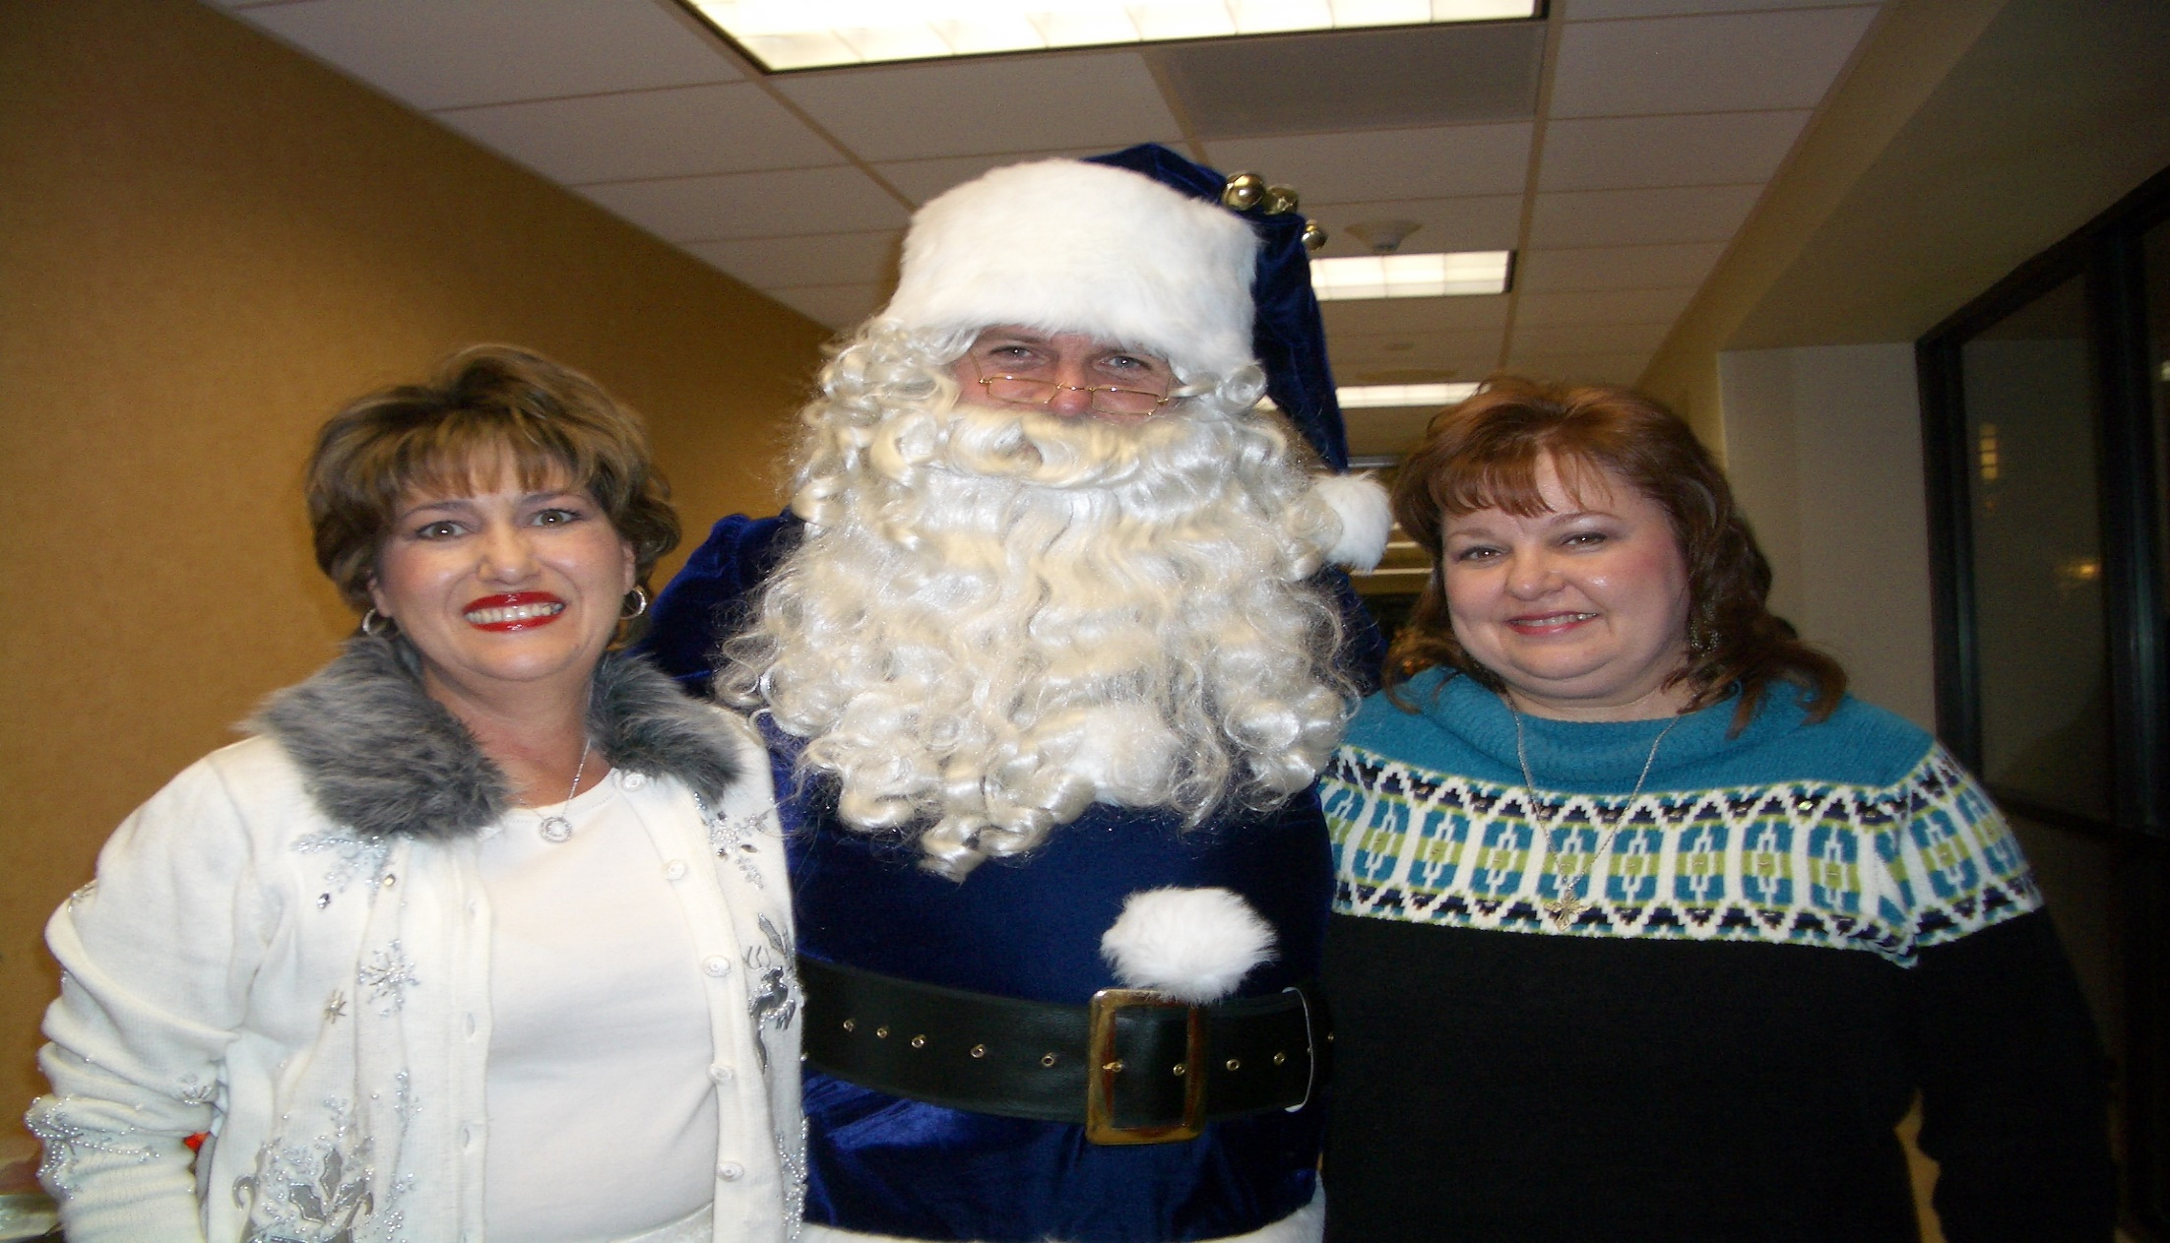
Community Projects

Slide 27
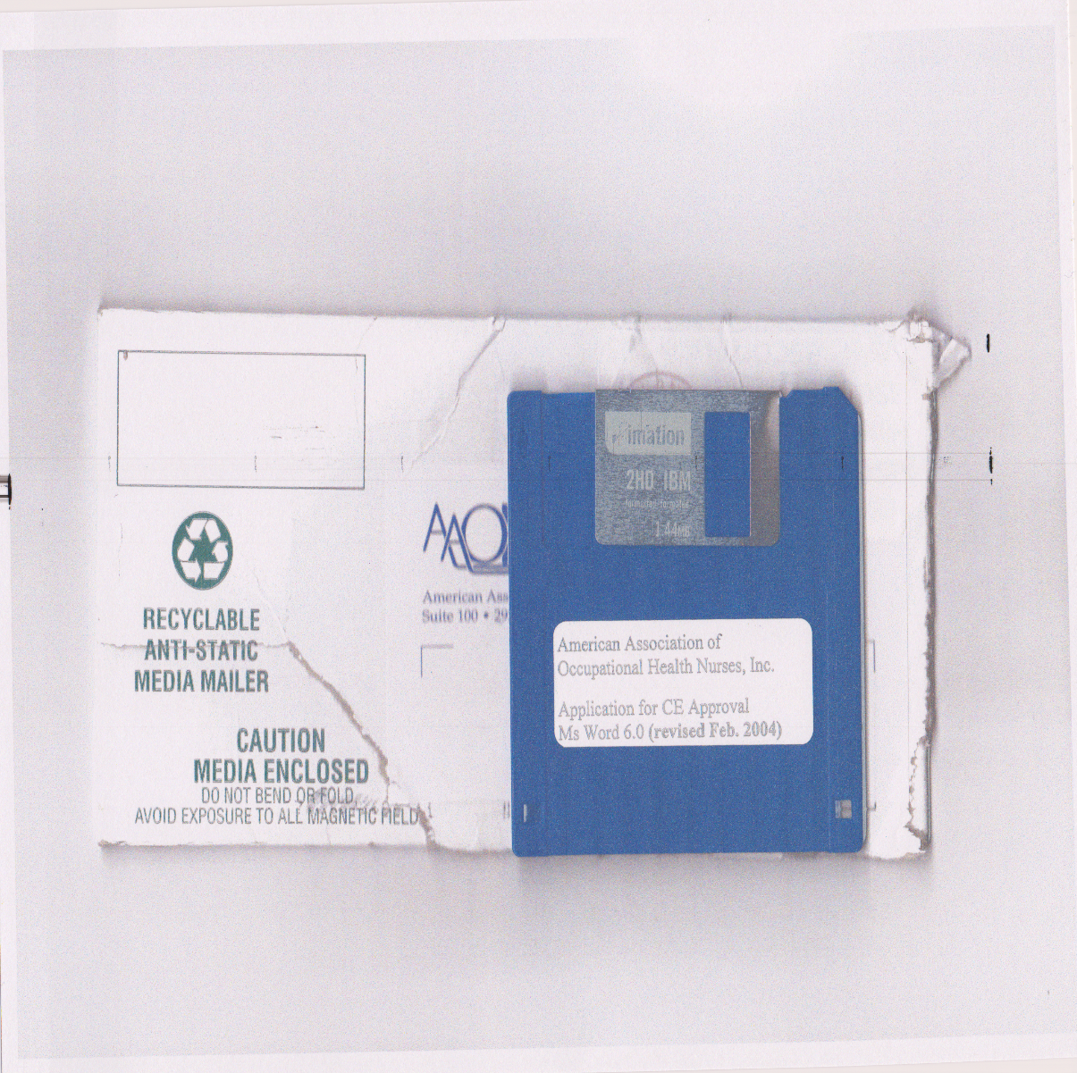
AAOHN CEU Approval DISC!

Slide 28
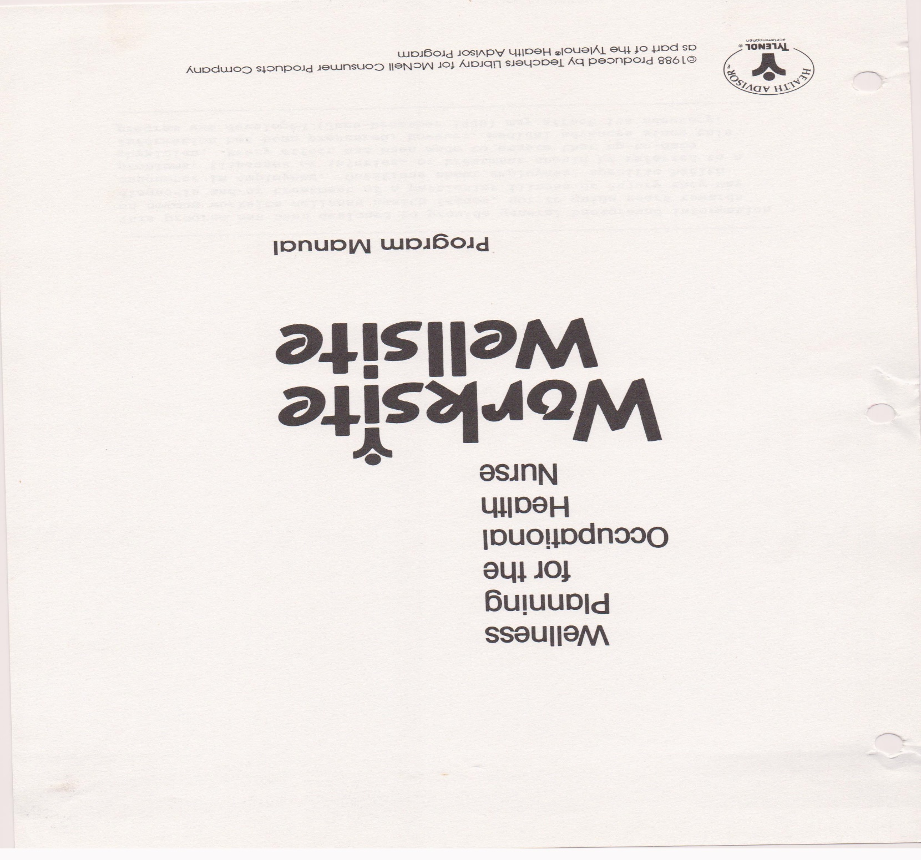
Wellness Program 1988

Slide 29
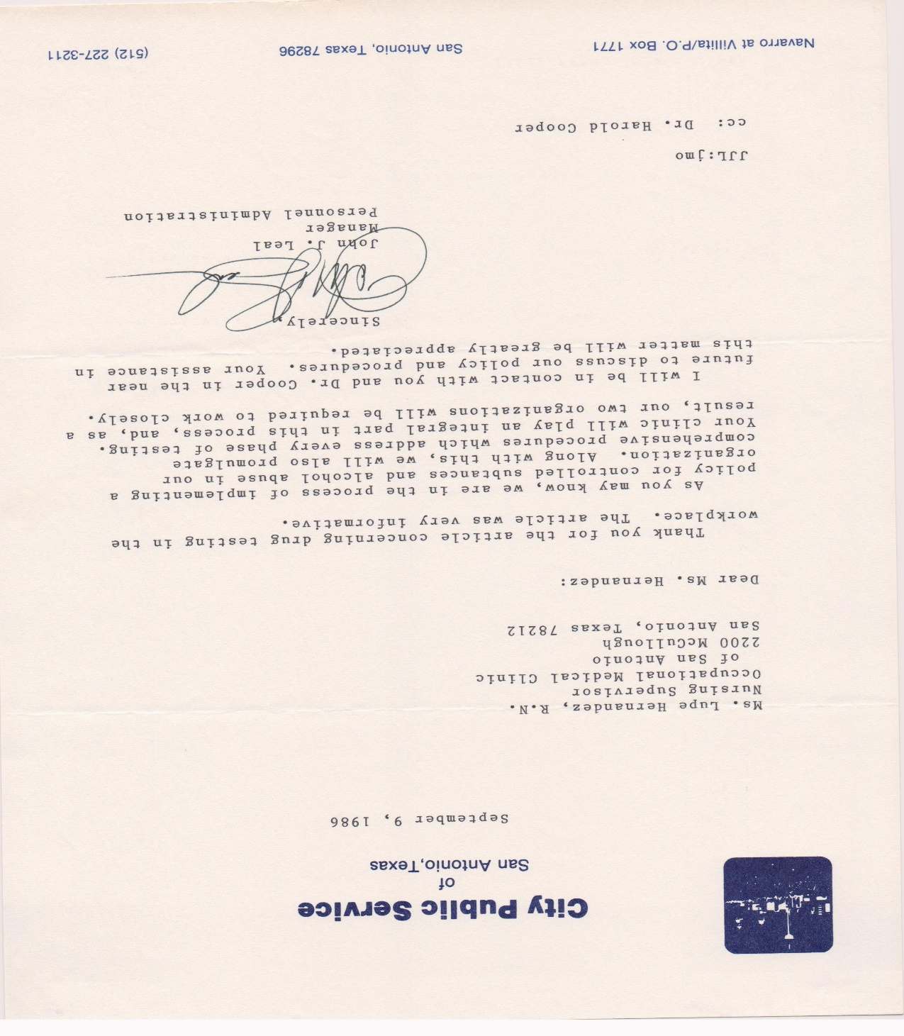
1986 Beginning Drug Screen Programs

Slide 30
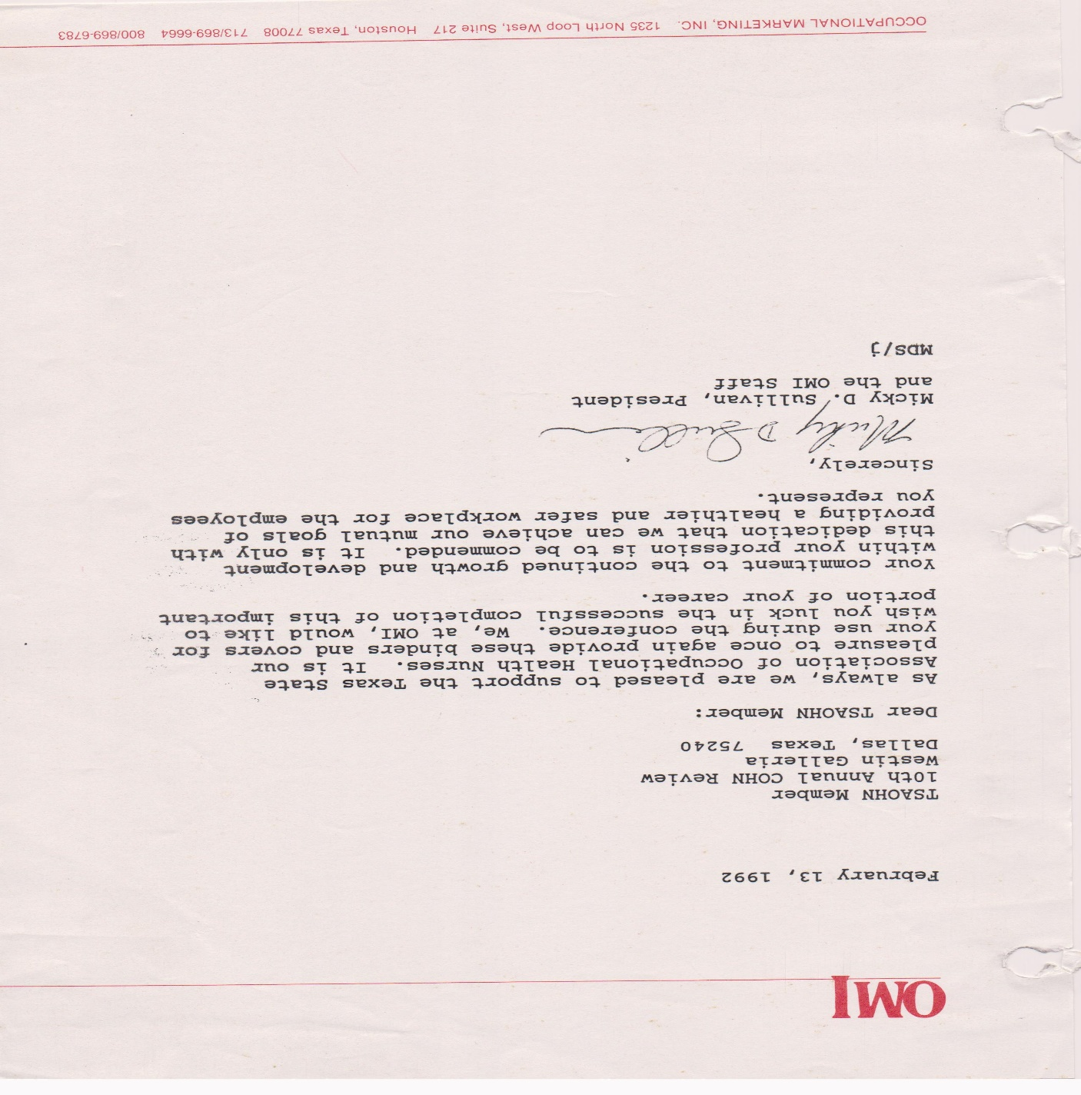
Historical TSAOHN Supporter

Slide 31
A Guide to the Texas State Association of Occupational Health Nurses Records, 1947-2008 Forms part of the History of Nursing Collection. Artifact requires appointment with artifacts curator. Contact repository.
Descriptive Summary
Creator: Texas State Association of Occupational Health Nurses
Title: Texas State Association of Occupational Health Nurses Records
Dates: 1947-2008
Abstract: Correspondence, minutes, agenda, reports, photographs, and awards compose the Texas State Association of Occupational Health Nurses (TSAOHN) Records, which documents the activities of the TSAOHN from its inception until 2008.
Accession No.: 98-393; 2009-196; 2010-309
Extent: 8 ft.
Language: Materials are written in English.
Repository: Dolph Briscoe Center for American History,The University of Texas at Austin
Scope and Contents
Correspondence, minutes, agenda, reports, photographs, and awards compose the Texas State Association of Occupational Health Nurses (TSAOHN) Records, which documents the activities of the TSAOHN from its inception until 2008. The records are organized into four series: Operating Records, TSAOHN History, Photographs, and Memorabilia and Awards. Organized by year, the first series, operating records, contains material from the Board of Directors, the President, the Vice President, the Secretary, the treasurer, the Historian, and various committees. Furthermore, Series I includes copies of the newsletter, copies of legislation concerning laws governing the Nursing practice, the by-laws, and conference records. This series also documents TSAOHN’s 50th anniversary celebration. The second series holds histories of individual chapters as well as primary documents compiled by TSAOHN on their history as an organization. Series III and Series IV consist of photographs, memorabilia and awards

Slide 32
Briscoe Center for American History
at The University of Texas at Austin
The Briscoe Center to welcomes the opportunity to acquire suitable historical materials to help build its collections. TSAOHN will be updating its existing donated material to the Briscoe Center in the upcoming year for its 65th birthday. You are welcome to contribute to the donation. We hope that you will. And you are welcome to visit your TSAOHN history on display.
Thank you for sharing this celebration with your TSAOHN partners !

